Slide 1
Russ S. Schumacher
Tips and tricks to make efficient use of Unix, the command line, and shell scripting
Department of Atmospheric Science, Colorado State University
16th AMS Student Conference
January 2017

Slide 2
What is UNIX/Linux/*nix ?
A computer operating system that allows for multiple users, and has a terminal or command line screen to perform key functions
“Among these is Apple's macOS,which is the Unix version with the largest installed base as of 2014.” (Wikipedia)
Usually, you’ll see it looking something like…
* “UNIX” is a trademarked name; systems using this name trace back to the original AT&T Unix. Other operating systems are “Unix-like”, including Linux, and are broadly referred to as *nix

Slide 3
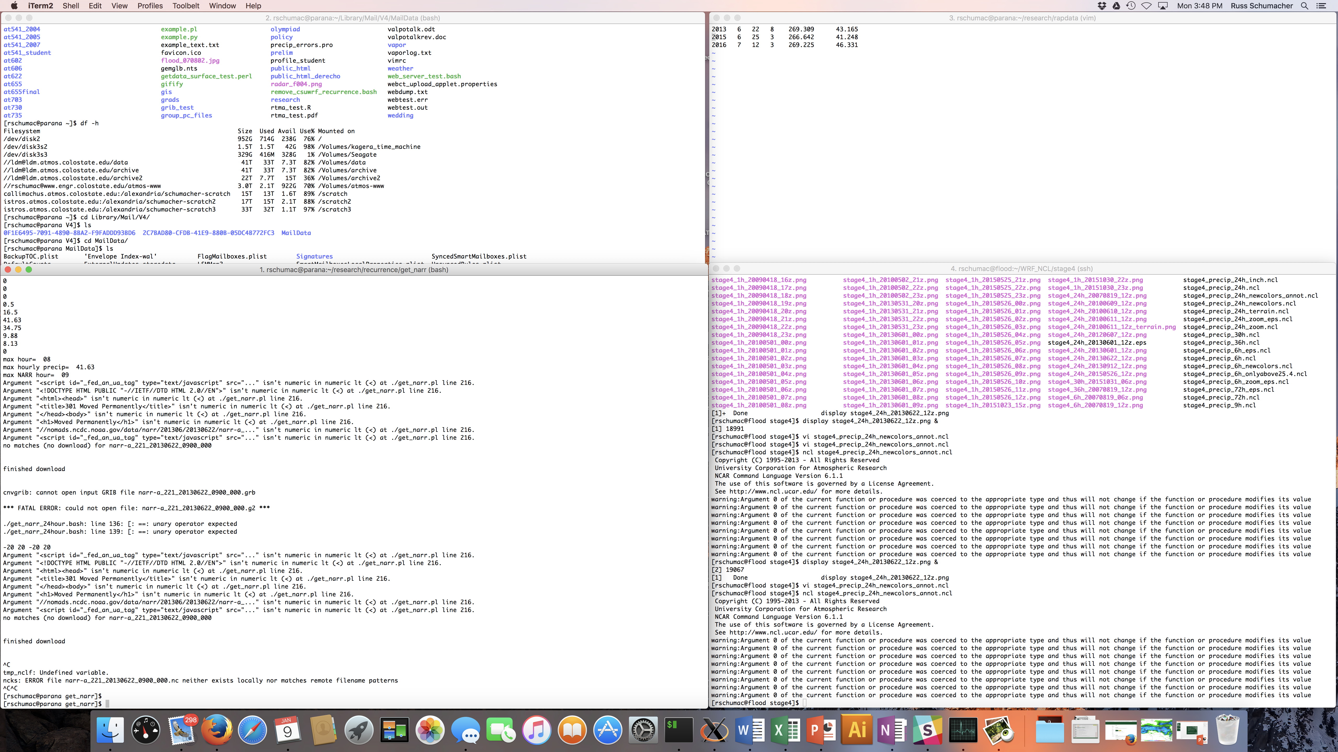
*actual screen shot from my Mac while preparing this presentation

Slide 4
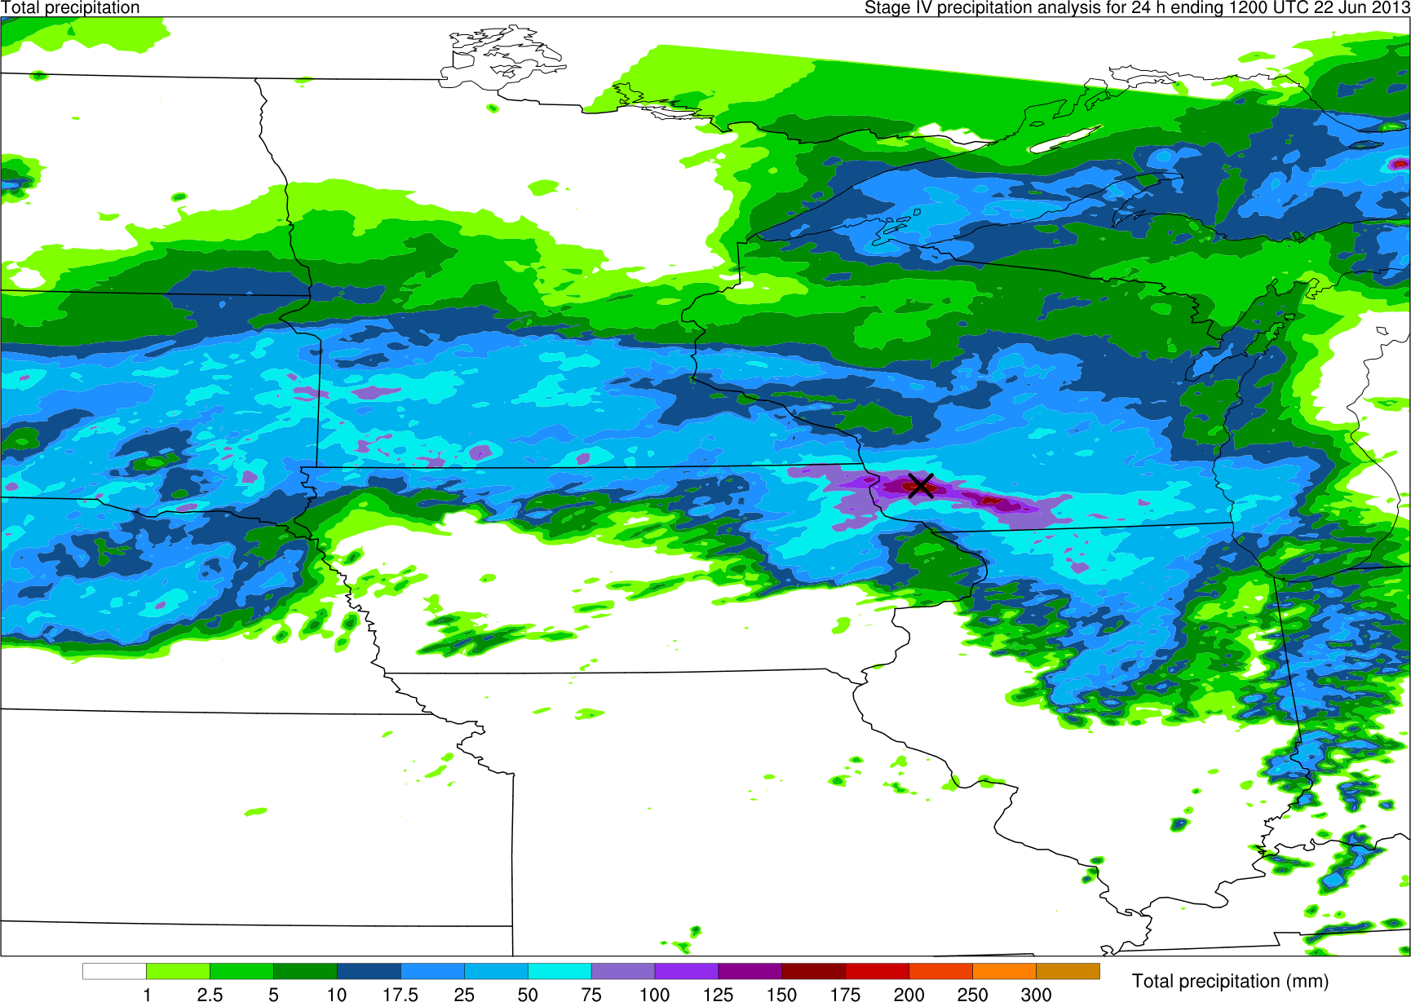
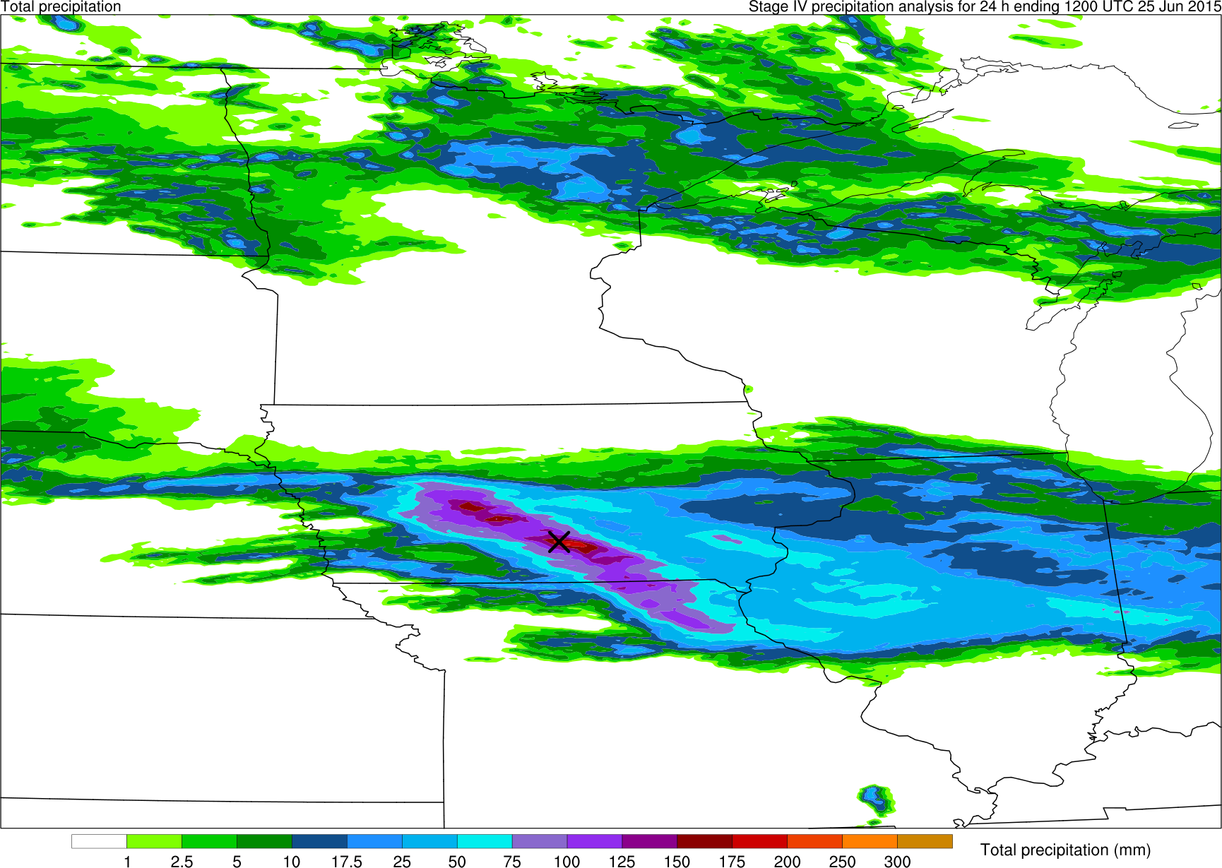
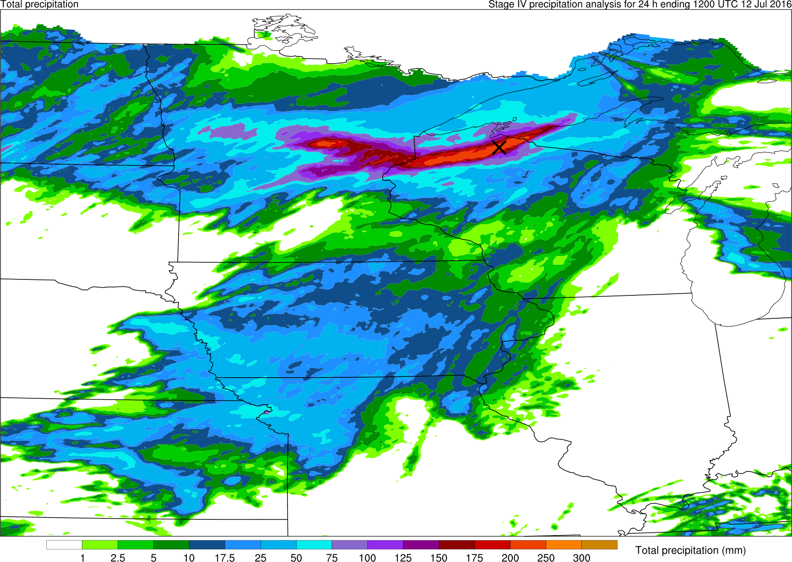
Command-line examples, working toward a research goal
A common task in my work: perform composite analysis over a number of heavy-rain events, but centered on the heaviest rainfall location:
X
X
22 June 2013
25 June 2015
X
12 July 2016

Slide 5
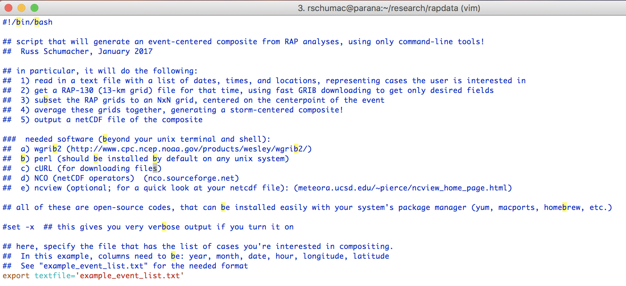
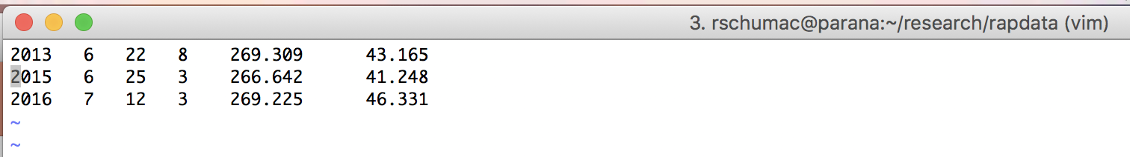
We can do this all from the command line, with a script!

Slide 6

What am I starting with?
Only 3 files! Two scripts (one of which comes straight from NOAA), and the list of cases

Slide 7
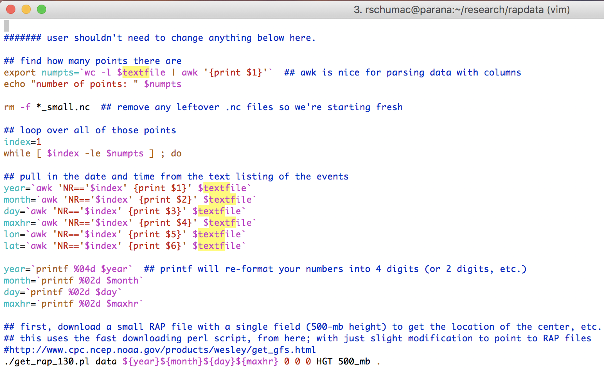
How does it work?

Slide 8
How does it work?

Slide 9
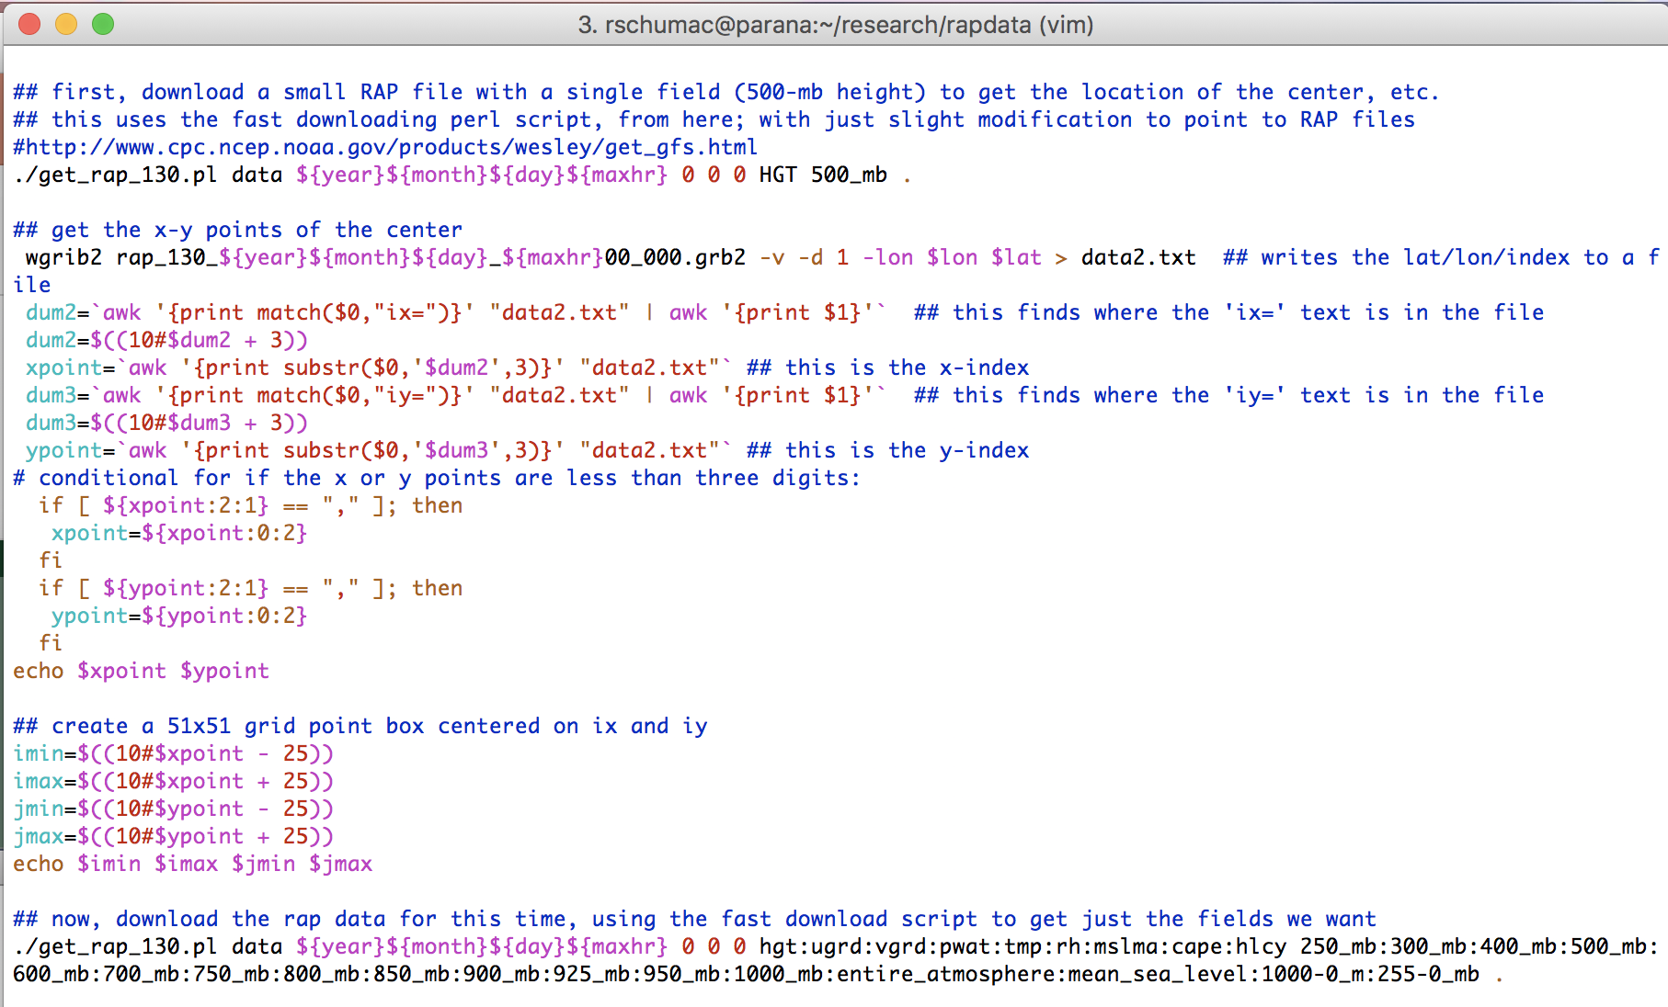
How does it work?

Slide 10
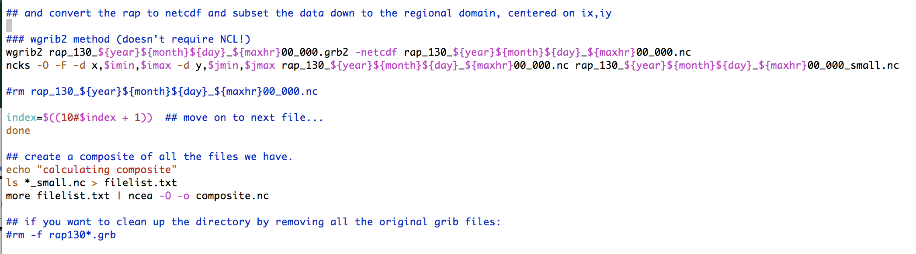
How does it work?
ncks = the “netCDF kitchen sink” : another *very* powerful tool!

Slide 11
How does it work?
ncea = netCDF ensemble averager (another part of NCO)

Slide 12
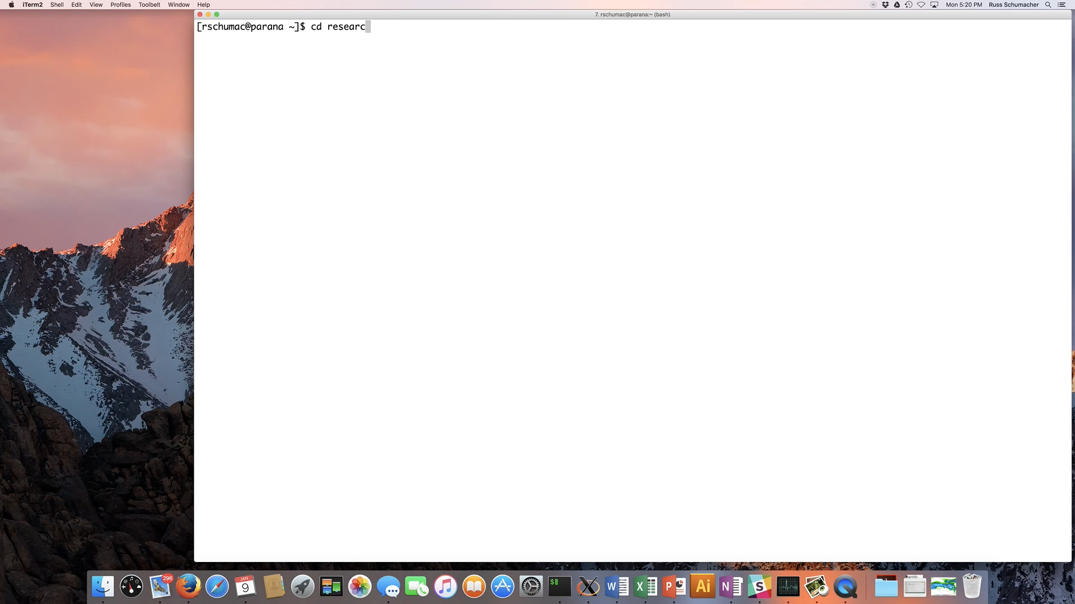

Slide 13
Concluding thoughts
There are command-line tools that can slice and dice your data very efficiently – this can speed up your work considerably if you take the time to learn them!
As an example: during my MS research, I probably spent several weeks struggling with various software packages to do the same thing that I just showed you in one minute
There are tons of resources out there – google will bring you the answer if you can figure out what to ask
The script used for this talk is on GitHub at: https://github.com/russ-schumacher/rapdata_demo
Questions: russ.schumacher@colostate.edu

